Slide 1


Department of Computer Science and Engineering
Smart Agriculture:IoT-Based Crop Monitoring And Management System
B21A2425C07
Madan A C
(210701136)
Makesh Kumar S
(210701144)
Mrs.Divya M
Assistant Professor

Slide 2
Problem Statement and Motivation
Traditional agricultural practices face significant challenges, including inefficient resource utilization, lack of real-time monitoring of environmental parameters, and the detrimental impact of weed growth on crop yields, particularly in crops like paddy. Manual methods of observation and intervention are time-consuming, labor-intensive, and error-prone, leading to reduced productivity and increased costs. Critical issues such as improper irrigation, suboptimal soil conditions, and unchecked weed growth exacerbate these problems, while the absence of an automated alert system delays timely action. Motivated by the need for sustainable and efficient farming practices, this project integrates IoT technology to provide real-time monitoring of essential environmental parameters and an automated notification system to alert farmers about critical conditions, such as low water levels or unsuitable soil pH. Additionally, a weed detection module addresses the specific challenges of paddy cultivation, reducing manual labor and promoting eco-friendly farming. By leveraging technology, this project aims to optimize resource utilization, enhance crop yields, and contribute to global food security.

Slide 3
Objectives
Real-Time Environmental Monitoring
Automated Notification System
Weed Detection Module
Improved Crop Productivity
Data Collection and Analysis
Sustainable Farming Practices

Slide 4
Abstract
This project leverages IoT and smart technologies to address critical challenges in agriculture, such as inefficient resource utilization, lack of real-time environmental monitoring, and the impact of weeds on crop yields, particularly in crops like paddy. The proposed smart agriculture system utilizes IoT-enabled sensors, including temperature, humidity, pH, and water level sensors, to collect real-time data on crop environments. This data is analyzed to provide actionable insights, enabling farmers to make informed decisions about irrigation, soil management, and overall crop health. An automated notification system alerts users when vital parameters, such as water levels, fall below optimal thresholds, ensuring timely interventions to prevent crop damage. Additionally, a weed detection module, powered by image processing and machine learning, identifies unwanted plant growth, reducing labor and dependence on herbicides. By integrating real-time monitoring, automated notifications, and advanced weed detection, the system promotes eco-friendly farming, optimizes resource utilization, and enhances crop productivity. Scalable and adaptable to diverse agricultural settings, this project advances sustainable farming practices and contributes to global food security.

Slide 5
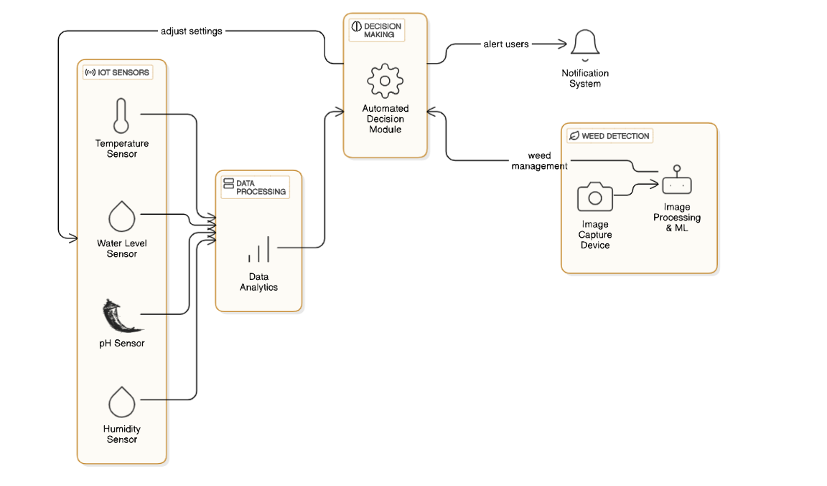
System Architecture

Slide 6
List of Modules
Sensor Data Acquisition Module
Automated Notification Module
Weed Detection Module

Slide 7
Sensor Data Acquisition Module
The Sensor Data Acquisition Module is responsible for collecting real-time environmental data from various IoT-enabled sensors deployed in the agricultural field. This module acts as the foundation of the system, ensuring accurate and continuous monitoring of critical parameters essential for crop health and resource optimization.

Slide 8
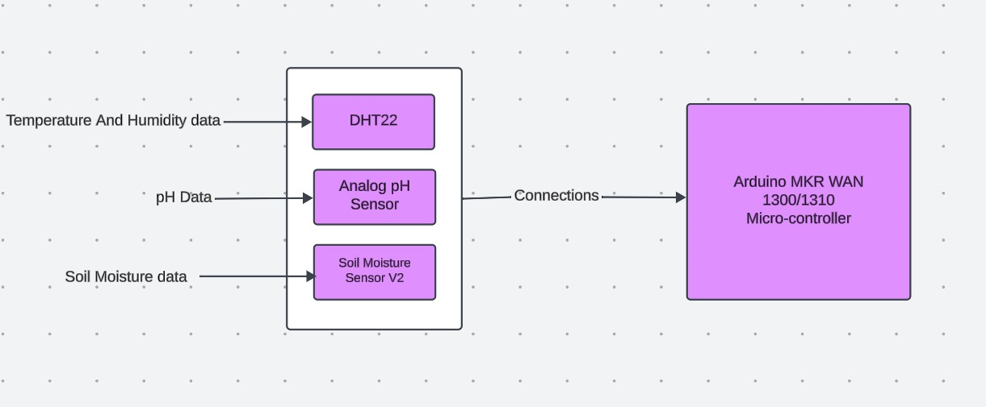
Data Flow Diagram

Slide 9
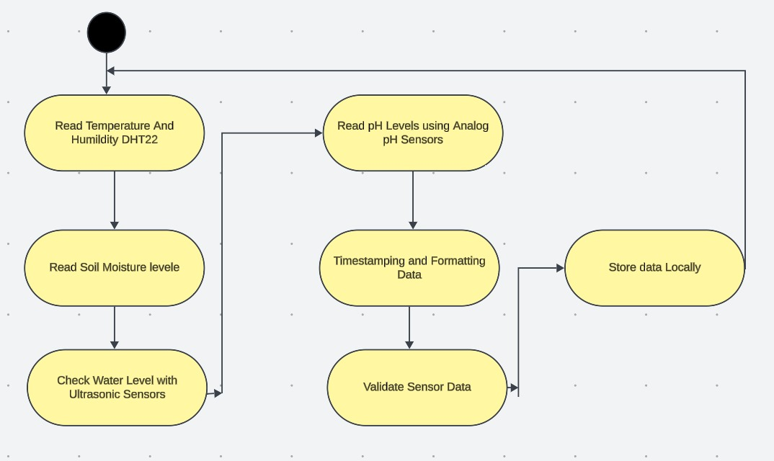
Activity Diagram

Slide 10
Automated Notification Module
The Automated Notification Module in this project is designed to alert users about critical changes in environmental conditions affecting crop health and growth. It continuously monitors real-time sensor data, such as water levels, soil moisture, temperature, humidity, and pH levels, to detect any deviations from predefined thresholds. Once an abnormality is identified, such as low water levels or extreme temperature conditions, the module processes the data, formats an appropriate notification message, and sends it to the user via various channels, including SMS, email, or a mobile app.

Slide 11
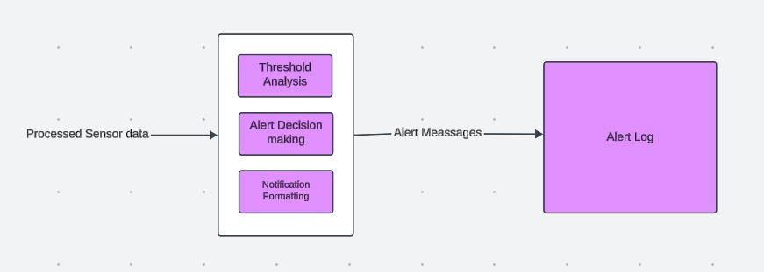
Data Flow Diagram

Slide 12
Weed Detection Module
The Weed detection module uses advanced image processing and machine learning to identify and classify unwanted plant growth in agricultural fields. By analyzing real-time images from cameras or drones, the system distinguishes between crops and weeds. This reduces the need for manual labor and minimizes herbicide use, promoting sustainable farming. The machine learning algorithms continuously improve accuracy, learning from new images and environmental conditions. Automated weed detection reduces operational costs and enhances crop yields by preventing weeds from overshadowing or damaging crops.

Slide 13
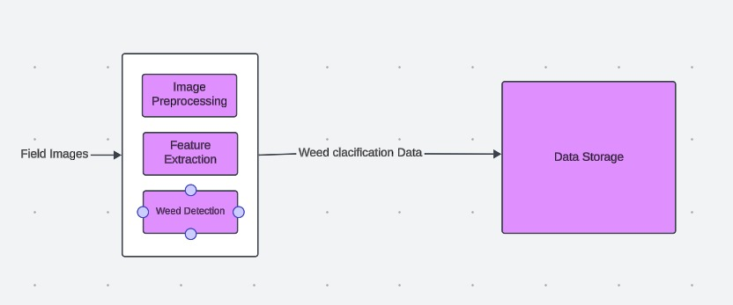
Data Flow Diagram

Slide 14
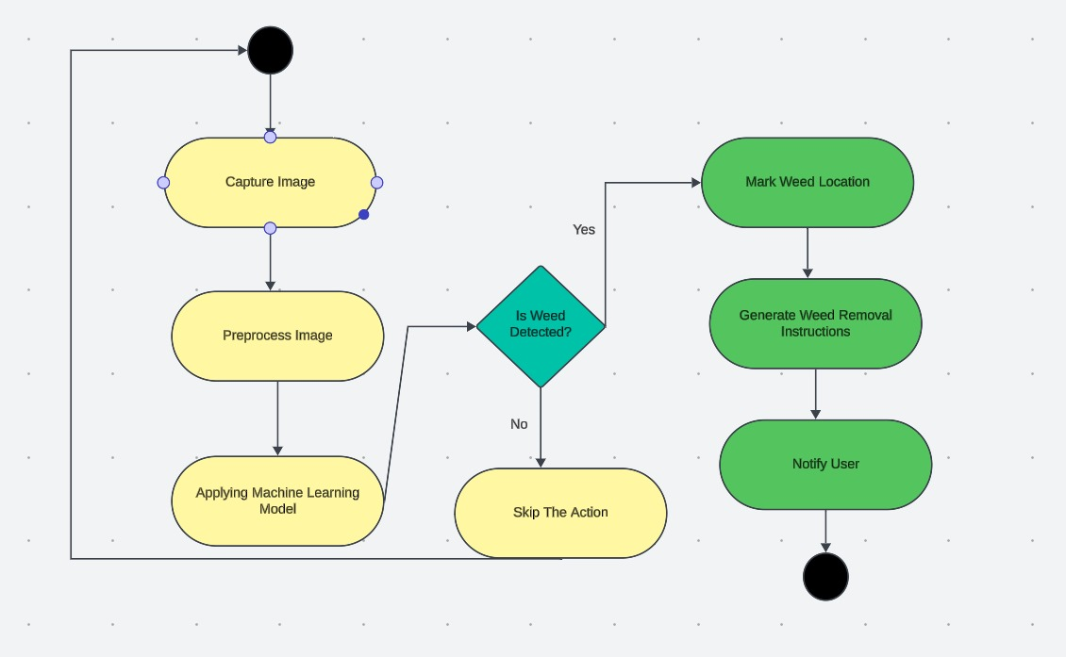
Activity Diagram

Slide 15
Implementation
Arduino UNO and Sensors Working
The Arduino UNO plays a central role in the project as the microcontroller responsible for interfacing with the various sensors and facilitating data acquisition. It acts as the primary hardware platform that reads real-time data from sensors, such as the temperature and humidity sensor (DHT11/DHT22), soil moisture sensor, water level sensor, and pH sensor.
The DHT22 is a digital sensor that measures temperature and humidity levels in the environment. It has a built-in thermistor and a capacitive humidity sensor. The sensor communicates with a microcontroller using a simple 1-wire protocol, sending the temperature and humidity data as a digital signal.

Slide 16
Implementation
The Analog pH sensor is used to measure the acidity or alkalinity of the soil, which is crucial for determining soil health and nutrient availability. The sensor works by using a pH-sensitive electrode that reacts with the soil's hydrogen ions. The sensor produces an analog voltage proportional to the pH value, which is read by the microcontroller.
The Soil Moisture Sensor V2 measures the volumetric water content in the soil. It works by passing a small electrical current through two probes inserted into the soil. The resistance to this current varies depending on the moisture level. When the soil is dry, the resistance is higher, and when the soil is wet, the resistance is lower.

Slide 17
Implementation
Model Selection and Training
1. Weed Detection Model Training:
Dataset Collection: To train the model, we need a labeled dataset of images with clearly marked weeds and crops. Ideally, we should gather images of the field taken from different angles, during different times of the day, and under various weather conditions to make the model robust.
Data Preprocessing: The raw images need to be pre-processed to standardize their size, enhance features, and remove noise.
Model Selection: Depending on the complexity of the task, we may choose between traditional computer vision methods (like Haar cascades or HOG features) or deep learning methods like CNNs. CNNs typically offer superior accuracy when trained with sufficient data.

Slide 18
Implementation
Model Selection: Depending on the complexity of the task, we may choose between traditional computer vision methods (like Haar cascades or HOG features) or deep learning methods like CNNs. CNNs typically offer superior accuracy when trained with sufficient data.
Model Training:Using CNN, the model is trained by feeding it labeled images and adjusting the internal parameters (weights) based on the error between predicted and actual labels.
Model Deployment: Once the model is trained, it can be deployed on an embedded system or edge device like the Arduino MKR WAN to run real-time weed detection directly in the field.

Slide 19
Conclusion & Work for Phase II
In Phase 2, the project will focus on transitioning from the prototype developed in Phase 1 to a fully functional system. This phase will involve gathering and labeling a diverse dataset for the weed detection module, training and validating the machine learning model using techniques like Convolutional Neural Networks (CNN), and integrating the model into the IoT system for real-time weed detection. Sensor calibration will be a priority to ensure accurate data from the DHT22, soil moisture sensor, and analog pH sensor, followed by testing the integration with the Arduino UNO microcontroller.

Slide 20
Conclusion & Work for Phase II
The wireless communication setup will be fine-tuned for long-distance data transmission using LoRa, and a user interface will be developed to provide farmers with real-time insights and alerts. Finally, the system will undergo field testing in real agricultural environments to gather feedback and make iterative improvements, optimizing the system for scalability and real-world effectiveness in promoting sustainable and efficient farming practices.

Slide 21
References
[1] Jaiswal, S. P., Bhadoria, V. S., Agrawal, A., & Ahuja, H. (2019). Internet of Things (IoT) for Smart Agriculture and Farming in Developing Nations. International Journal of Scientific & Technology Research (IJSTR), 8(12), 1049–1056.
[2] Elijah, O., Rahman, T. A., Orikumhi, I., Leow, C. Y., &Hindia, M. N. (2018). An Overview of Internet of Things (IoT) and Data Analytics in Agriculture: Benefits and Challenges. IEEE Internet of Things Journal, 5(5), 3758–3775. DOI: 10.1109/JIOT.2018.2844296.
[3] Lokhande, S. A. (2021). Effective Use of Big Data in Precision Agriculture. Proc. Int. Conf. Emerg. Smart Comput. Informat. (ESCI), 312–316. DOI: 10.1109/ESCI50559.2021.9396813.
[4] Kounalakis, T., Triantafyllidis, G. A., &Nalpantidis, L. (2019). Deep Learning-Based Visual Recognition of Rumex for Robotic Precision Farming. Computers and Electronics in Agriculture, 165, Article 104973. DOI: 10.1016/j.compag.2019.104973.

Slide 22
References
[5] Chang, C.-L., & Lin, K.-M. (2018). Smart Agricultural Machine with a Computer Vision-Based Weeding and Variable-Rate Irrigation Scheme. Robotics, 7(3), Article 38. DOI: 10.3390/robotics7030038.[2] Elijah, O., Rahman, T. A., Orikumhi, I., Leow, C. Y., &Hindia, M. N. (2018). An Overview of Internet of Things (IoT) and Data Analytics in Agriculture: Benefits and Challenges. IEEE Internet of Things Journal, 5(5), 3758–3775. DOI: 10.1109/JIOT.2018.2844296.
[6] Shamshiri, R. R., Weltzien, C., Hameed, I. A., Yule, I. J., Grift, T. E., Balasundram, S. K., ... Chowdhary, G. (2018). Research and Development in Agricultural Robotics: A Perspective of Digital Farming. International Journal of Agricultural and Biological Engineering, 11, 1–14.[4] Kounalakis, T., Triantafyllidis, G. A., &Nalpantidis, L. (2019). Deep Learning-Based Visual Recognition of Rumex for Robotic Precision Farming. Computers and Electronics in Agriculture, 165, Article 104973. DOI: 10.1016/j.compag.2019.104973.

Slide 23
References
[7] Murugesan, R., Sudarsanam, S. K., Malathi, G., Vijayakumar, V., Neelanarayanan, V., Venugopal, R., ... Saha, S. (2019). Artificial Intelligence and Agriculture 5.0. International Journal of Recent Technology and Engineering, 8, 1870–1877.[6] Shamshiri, R. R., Weltzien, C., Hameed, I. A., Yule, I. J., Grift, T. E., Balasundram, S. K., ... Chowdhary, G. (2018). Research and Development in Agricultural Robotics: A Perspective of Digital Farming. International Journal of Agricultural and Biological Engineering, 11, 1–14.[4] Kounalakis, T., Triantafyllidis, G. A., &Nalpantidis, L. (2019). Deep Learning-Based Visual Recognition of Rumex for Robotic Precision Farming. Computers and Electronics in Agriculture, 165, Article 104973. DOI: 10.1016/j.compag.2019.104973.
[8] Li, S., Yuan, F., Ata-UI-Karim, S. T., Zheng, H., Cheng, T., Liu, X., ... Cao, Q. (2019). Combining Color Indices and Textures of UAV-Based Digital Imagery for Rice LAI Estimation. Remote Sensing, 11, Article 1763.
[9] Li, S., Ding, X., Kuang, Q., Ata-UI-Karim, S. T., Cheng, T., Liu, X., ... Cao, Q. (2018). Potential of UAV-Based Active Sensing for Monitoring Rice Leaf Nitrogen Status. Frontiers in Plant Science, 9, 1–14.
[10] Alonso, R. S., Sittón-Candanedo, I., García, Ó., Prieto, J., & Rodríguez-González, S. (2020). An Intelligent Edge-IoT Platform for Monitoring Livestock and Crops in a Dairy Farming Scenario. Ad Hoc Networks, 98, Article 102047.
[11] Han, L., Yang, G., Yang, H., Xu, B., Li, Z., & Yang, X. (2018). Clustering Field-Based Maize Phenotyping of Plant-Height Growth and Canopy Spectral Dynamics Using a UAV Remote-Sensing Approach. Frontiers in Plant Science, 9, 1–18.
[12] Boonchieng, E., Chieochan, O., &Saokaew, A. (2018). Smart Farm: Applying the Use of NodeMCU, IOT, NETPIE, and LINE API for a Lingzhi Mushroom Farm in Thailand. IEICE Transactions on Communications, 101(1), 16–23.
[13] Cambra, C., Sendra, S., Lloret, J., & Lacuesta, R. (2018). Smart System for Bicarbonate Control in Irrigation for Hydroponic Precision Farming. Sensors, 18, Article 1333.
[14] Azimi Mahmud, M. S., Buyamin, S., Mokji, M. M., & Abidin, M. S. Z. (2018). Internet of Things-Based Smart Environmental Monitoring for Mushroom Cultivation. Indonesian Journal of Electrical Engineering and Computer Science, 10(3), 847–852.

Slide 24
References
[15] Jawad, H., Nordin, R., Gharghan, S., Jawad, A., Ismail, M., & Abu-AlShaeer, M. (2018). Power Reduction with Sleep/Wake on Redundant Data (SWORD) in a Wireless Sensor Network for Energy-Efficient Precision Agriculture. Sensors, 18(10), 3450.[8] Li, S., Yuan, F., Ata-UI-Karim, S. T., Zheng, H., Cheng, T., Liu, X., ... Cao, Q. (2019). Combining Color Indices and Textures of UAV-Based Digital Imagery for Rice LAI Estimation. Remote Sensing, 11, Article 1763.
[16] Jin, X.-B., Yang, N.-X., Wang, X.-Y., Bai, Y.-T., Su, T.-L., & Kong, J.-L. (2020). Hybrid Deep Learning Predictor for Smart Agriculture Sensing Based on Empirical Mode Decomposition and Gated Recurrent Unit Group Model. Sensors, 20(5), Article 1334.[10] Alonso, R. S., Sittón-Candanedo, I., García, Ó., Prieto, J., & Rodríguez-González, S. (2020). An Intelligent Edge-IoT Platform for Monitoring Livestock and Crops in a Dairy Farming Scenario. Ad Hoc Networks, 98, Article 102047.
[17] Xia, J., Huang, B., Yang, Y. W., Cao, H. X., Zhang, W., Xu, L., ... Ge, D. (2018). Hyperspectral Identification and Classification of Oilseed Rape Waterlogging Stress Levels Using Parallel Computing. IEEE Access, 6, 57663–57675.[12] Boonchieng, E., Chieochan, O., &Saokaew, A. (2018). Smart Farm: Applying the Use of NodeMCU, IOT, NETPIE, and LINE API for a Lingzhi Mushroom Farm in Thailand. IEICE Transactions on Communications, 101(1), 16–23.
[18] Xue, J., Fan, Y., Su, B., & Fuentes, S. (2019). Assessment of Canopy Vigor Information from Kiwifruit Plants Based on a Digital Surface Model from Unmanned Aerial Vehicle Imagery. International Journal of Agricultural and Biological Engineering, 12, 165–171.
[19] Uddin, M. A., Mansour, A., L. Jeune, M., Ayaz, M., & Aggoune, E.-H. M. (2018). UAV-Assisted Dynamic Clustering of Wireless Sensor Networks for Crop Health Monitoring. Sensors, 18, Article 555.
[20] Sadowski, S., &Spachos, P. (2020). Wireless Technologies for Smart Agricultural Monitoring Using Internet of Things Devices with Energy Harvesting Capabilities. Computers and Electronics in Agriculture, 172, Article 105338.
[21] Kumar, P., Kumar, S.V. (2023). Precise and Accurate Farming Framework Utilizing IoT. In: Joshi, A., Mahmud, M., Ragel, R.G. (eds) Information and Communication Technology for Competitive Strategies (ICTCS 2022). ICTCS 2022. Lecture Notes in Networks and Systems, vol 623. pp 293-301, Springer, Singapore

Slide 25
References
[21] K. P, V. K. S and S. P. S(2024), "CNN and Edge-Based Segmentation for the Identification of Medicinal Plants," 2024 5th International Conference on Intelligent Communication Technologies and Virtual Mobile Networks (ICICV), Tirunelveli, India, 2024, pp. 89-94, doi: 10.1109/ICICV62344.2024.00021.

Slide 26
Paper Publication Status
Uploaded in confidence And watting for acceptence Mail .

Slide 27
Thank You

